Slide 1

Large Scale Machine Learning: Decision Trees
Note to other teachers and users of these slides: We would be delighted if you found our
material useful for giving your own lectures. Feel free to use these slides verbatim, or to
modify them to fit your own needs. If you make use of a significant portion of these slides
in your own lecture, please include this message, or a link to our web site: http://www.mmds.org
CS246: Mining Massive Datasets
Jure Leskovec, Stanford University
Mina Ghashami, Amazon
http://cs246.stanford.edu
Notes:
Building large scale machine learning models
Why it is a very useful model to know
DT are predictive models

Slide 2
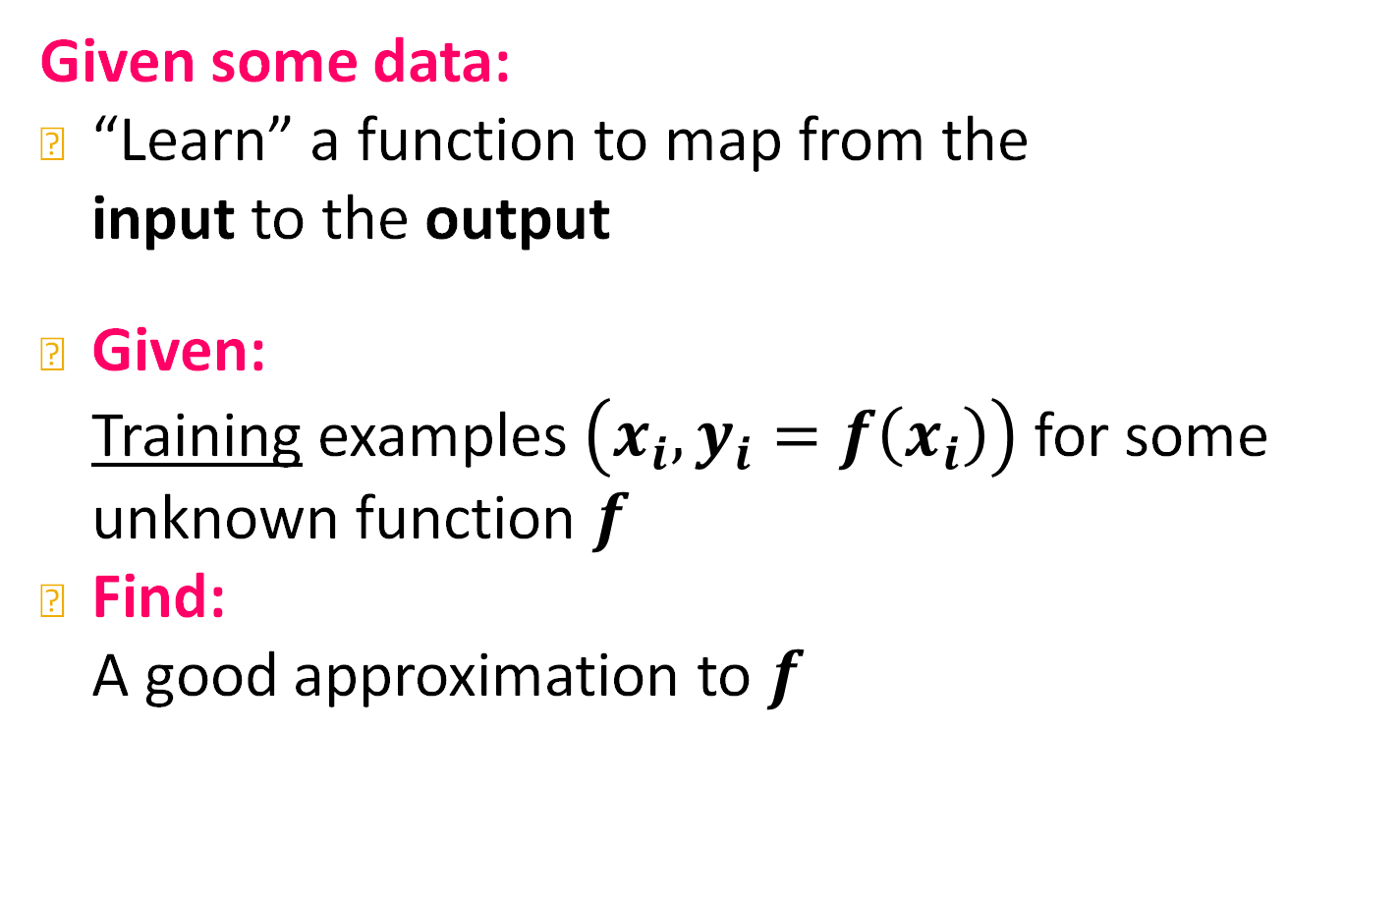
Supervised Learning
Given some data:
“Learn” a function to map from the input to the output
Given: Training examples $\left(x_{i}, y_{i}=f\left(x_{i}\right)\right)$ for some unknown function $f$
Find: A good approximation to $f$
Notes:
Unsupervised learning: clustering, Dim Reduction, SVD
Self supervised learning: node embedding, supervision does not come from outside, not task specific, but supervision come from the data

Slide 3
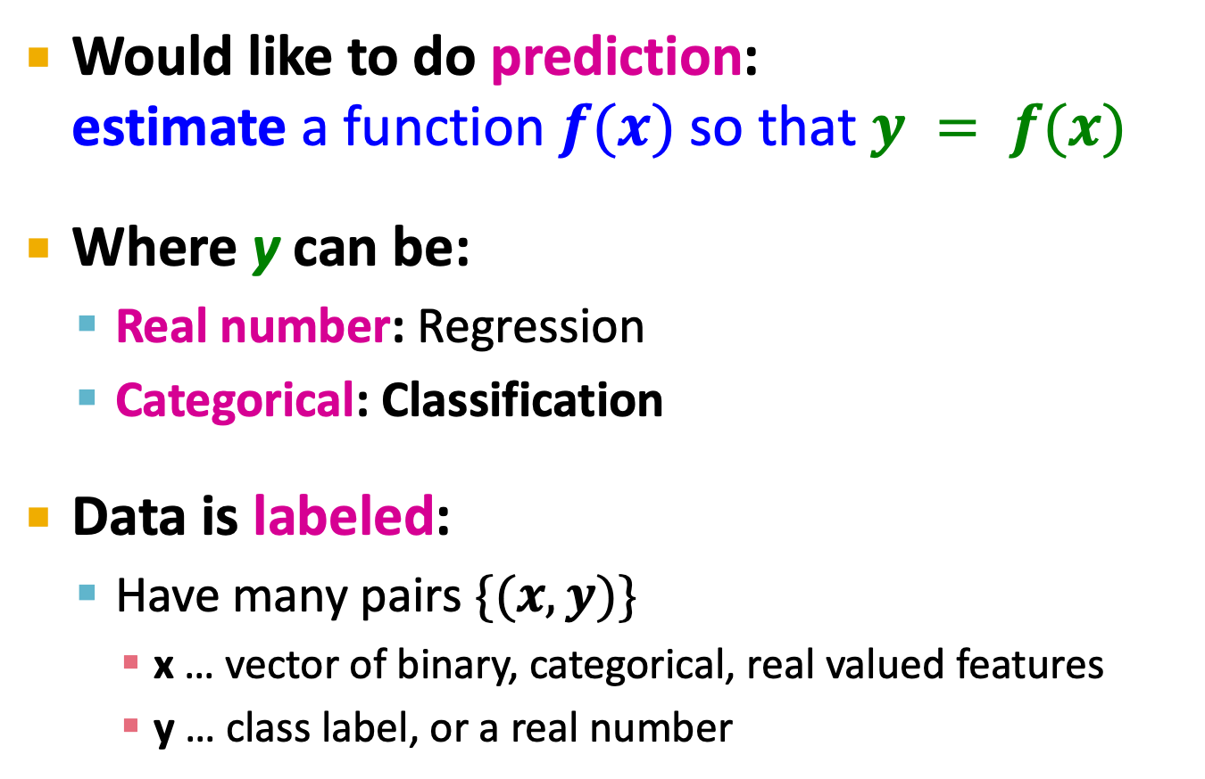
Supervised Learning
Would like to do prediction:
estimate a function $f(x)$ so that $y = f(x)$
Where y can be:
Real number: Regression
Categorical: Classification
Data is labeled:
Have many pairs $\{(x, y)\}$
x … vector of binary, categorical, real valued features
y … class label, or a real number

Slide 4
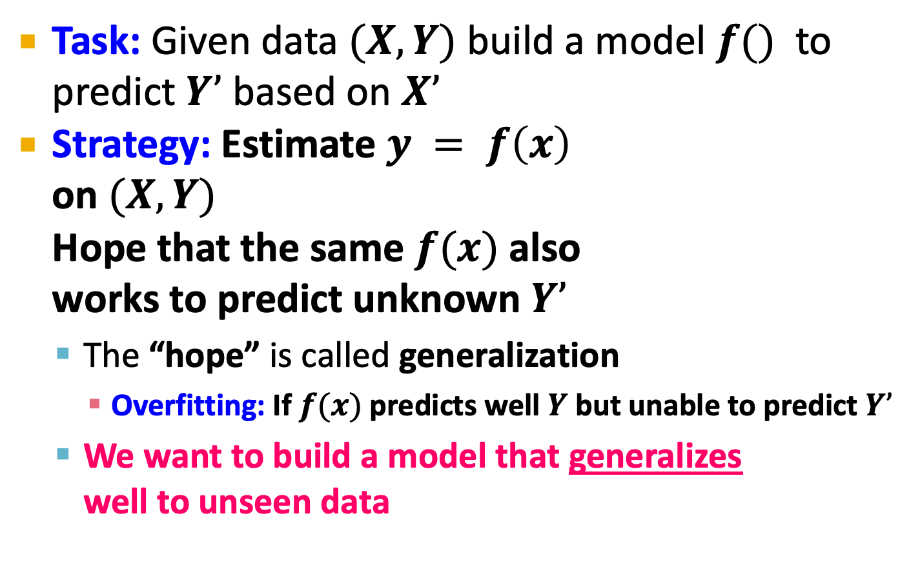
Supervised Learning
Task: Given data $(X,Y)$ build a model $f()$ to predict $Y’$ based on $X’$
Strategy: Estimate $y = f\left(x\right)$ on $(X,Y)$ Hope that the same $f(x)$ also works to predict unknown $Y’$
The “hope” is called generalization
Overfitting: If $f(x)$predicts well $Y$ but unable to predict $Y’$
We want to build a model that generalizes well to unseen data
X
Y
Training data
Test data
X’
Y’
Notes:
You oculd do a perfect prediciton on train data by simply memorize the data... But that wont generalize to the new test data!! That’s why ML is hard, tuning algorithms, picking right parameters is necessary. You deploy ML into real world and that’s the real evaluation of your model

Slide 5
Decision Trees, Random Forests and GBDTs

Slide 6
Preface: Decision Trees
Decision trees are part of ML since 1980s
Introduced by Leo Breiman in 1984
Notable algorithms: ID3, C4.5
More recent innovations include:
Boosted decision trees (gradient boosted DT)
Random forest
Even though DTs are old, hand-engineered and heuristic, they are a method of choice for tabular data and for Kaggle competitions. ☺
Notes:
DT have a long history, they started in 1980s...
Additional innovations: boosted DT, random forest
They are a method of choice when working with tabular data, When you are working with tabular data and most data in the world is tabular because it comes from relational databases.

Slide 7
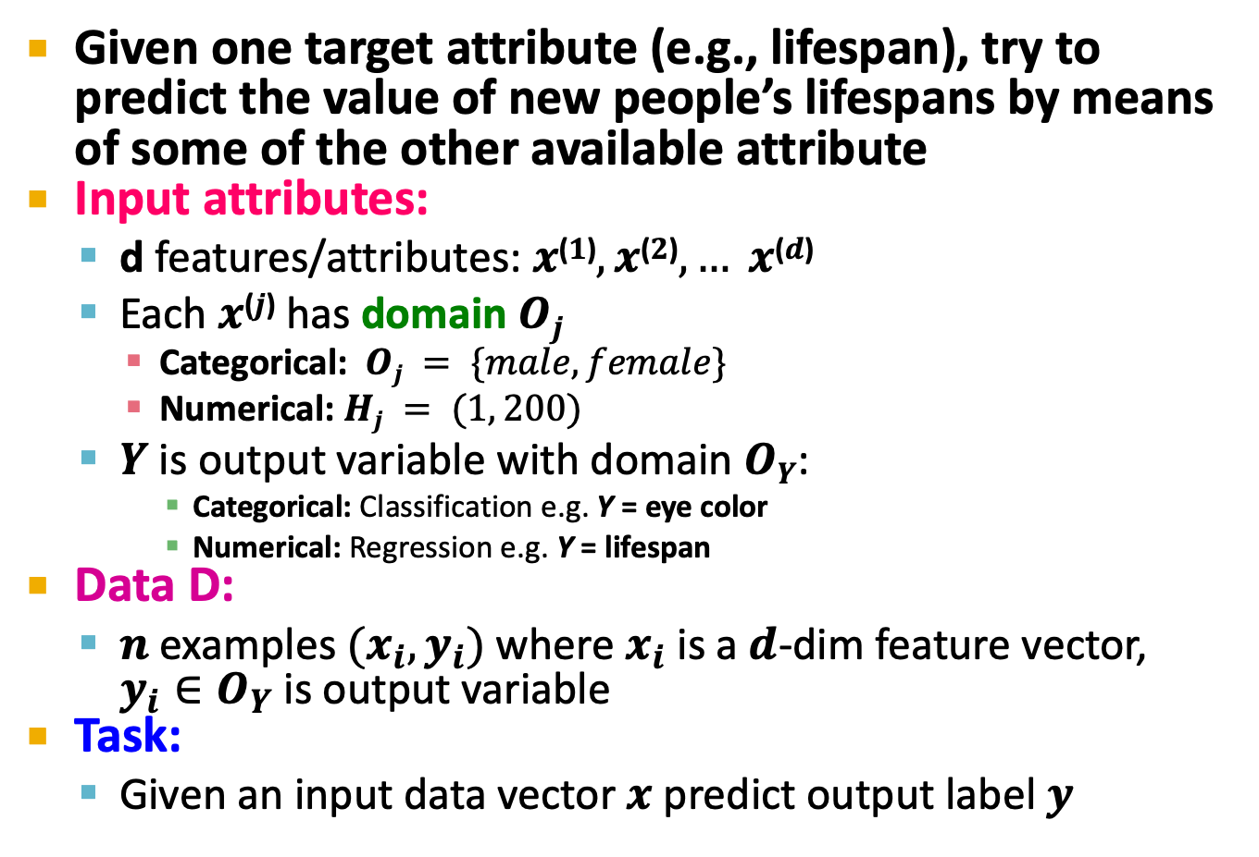
Decision Tree Learning
Given one target attribute (e.g., lifespan), try to predict the value of new people’s lifespans by means of some of the other available attribute
Input attributes:
d features/attributes: $x$⁽$1$⁾$, x$⁽$2$⁾$, … x$⁽$d$⁾
Each $x$⁽$j$⁾ has domain $Oj$
Categorical: $Oj = \{male, female\}$
Numerical: $Hj = (1, 200)$
$Y$ is output variable with domain $OY$:
Categorical: Classification e.g. Y = eye color
Numerical: Regression e.g. Y = lifespan
Data D:
$n$ examples $(x_{i}, y_{i})$where $x_{i}$ is a $d$-dim feature vector, $y_{i}∈O_{Y}$ is output variable
Task:
Given an input data vector $x$ predict output label $y$
Notes:
X is the characteristic of the person
Subscript: refers to person i
Superscript: refers to feature j

Slide 8
Decision Trees
A Decision Tree is a tree-structured plan of a set of attributes to test in order to predict the output
A
yes
no
X⁽¹⁾<v⁽¹⁾
Y= 0.42
C
X⁽²⁾∈{v⁽²⁾, v⁽³⁾}
D
F
F
G
H
I

Slide 9

Decision Trees
Decision trees:
Split the data at each internal node
Each leaf node makes a prediction
Lecture today:
Binary splits: $X\text{(}j\text{)}<v$
Numerical attributes
A
yes
no
X⁽¹⁾<v⁽¹⁾
Y= 0.42
C
X⁽²⁾<v⁽²⁾
D
F
X⁽³⁾<v⁽⁴⁾
X⁽²⁾<v⁽⁵⁾
F
G
H
I

Slide 10

How to make predictions?
Input: Example $xi$
Output: Predicted $\hat{y_{i}}$
“Drop” $xi$ down the tree until it hits a leaf node
Predict the value stored in the leaf that $xi$hits
A
yes
no
X⁽¹⁾<v⁽¹⁾
Y= 0.42
C
X⁽²⁾<v⁽²⁾
D
F
X⁽³⁾<v⁽⁴⁾
X⁽²⁾<v⁽⁵⁾
F
G
H
I

Slide 11


Decision Trees: feature space
Alternative view:
+
Data is 2-dim:
$$x=x^{\left(1\right)},x^{\left(2\right)}$$
+
+
+
+
–
–
+
+
+
–
$$y=\{+,−\}$$
+
+
Class label:
+
–
+
+
+
+
+
–
+
–
+
+
–
–
–
X⁽¹⁾
–
+
+
–
+
–
+
–
–
–
+
–
+
+
–
–
+
+
+
+
–
+
+
+
+
+
+
–
+
–
+
+
+
X⁽²⁾
Notes:
Here we are looking at binary classification task, where label takes either + or -. There are two classes.
DT finely chops and partitions decision space into regions. It has complex decision boundaries.
Usually you train multiple shallow trees and combine their resultk, rather than making one deep tree.

Slide 12
Decision Trees: feature space
Alternative view:
V⁽³⁾
+
A
+
+
+
+
–
–
yes
No
+
+
+
+
+
–
X⁽¹⁾<v⁽¹⁾
+
–
+
F
C
+
+
+
+
–
X⁽²⁾<v⁽²⁾
+
X⁽²⁾<v⁽³⁾
V⁽¹⁾
–
Y= +
D
Y= +
Y= –
+
+
–
–
–
X⁽¹⁾
–
+
+
–
X⁽²⁾<v⁽⁴⁾
+
–
+
–
–
–
Y= –
+
–
H
+
+
–
–
V⁽⁵⁾
X⁽¹⁾<v⁽⁵⁾
+
+
+
+
–
+
Y= +
Y= –
+
+
+
+
+
–
+
–
+
+
+
V⁽²⁾
X⁽²⁾
V⁽⁴⁾
Notes:
Here we are looking at binary classification task, where label takes either + or -. There are two classes.
DT finely chops and partitions decision space into regions. It has complex decision boundaries.
Usually you train multiple shallow trees and combine their result, rather than making one deep tree.

Slide 13

How to construct a tree?
Training dataset $D^{∗}, |D^{∗}|=100$examples
# of examples traversing the edge
A
|D|=10
|D|=90
X⁽¹⁾<v⁽¹⁾
Y= 0.42
B
C
|D|=45
|D|=45
X⁽²⁾<v⁽²⁾
D
E
|D|=20
|D|=25
|D|=15
|D|=30
X⁽³⁾<v⁽⁴⁾
X⁽²⁾<v⁽⁵⁾
F
G
H
I
Notes:
Do we create a split node or do we create a leaf node, make a prediction and stop building the tree.
Whatever comes from the parent either goes to the left child or to the right child.

Slide 14
How to construct a tree?
A
Imagine we are currently at some node G
Let D_{G} be the data that reaches G
There is a decision we have to make: Do we continue building the tree?
If yes, which variable and which value do we use for a split?
Continue building the tree recursively
If not, how do we make a prediction?
We need to build a “predictor node”
B
C
D
E
F
G
H
I

Slide 15
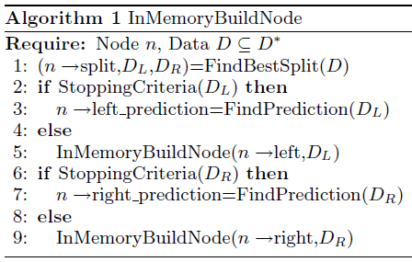
3 steps in constructing a tree
BuildSubtree
(1)
(2)
(3)
BuildSubtree
BuildSubtree
Requires at least a single pass over the data!
Notes:
One level of tree requires a single pass over data

Slide 16
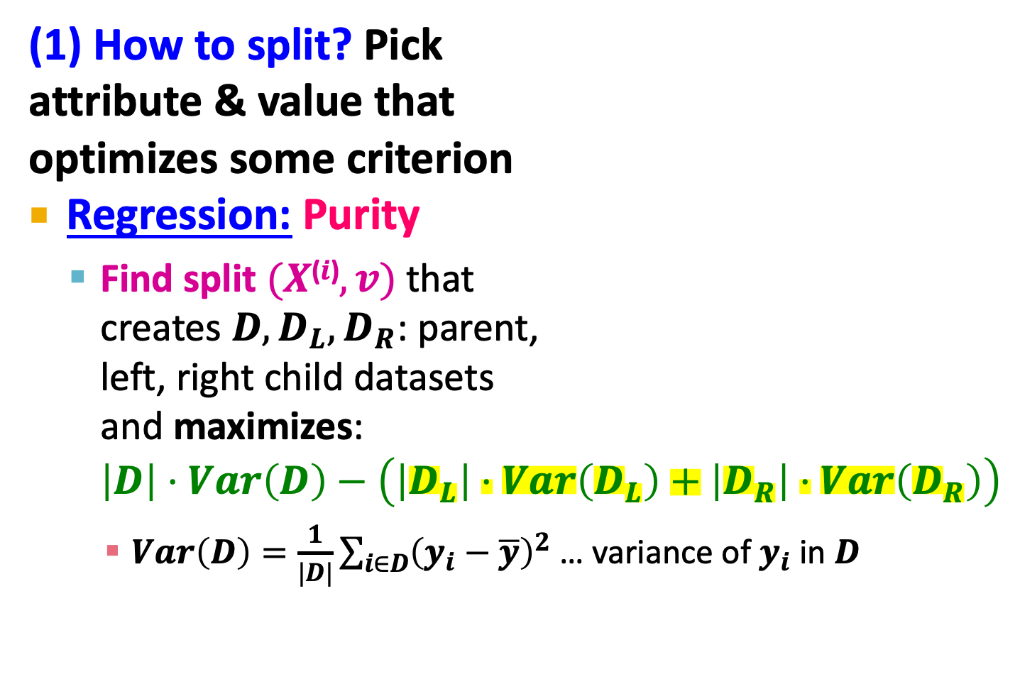
How to construct a tree?
(1) How to split? Pick attribute & value that optimizes some criterion
Regression: Purity
Find split $(X\text{(}i\text{)}, v)$that creates $D, D_{L}, D_{R}$: parent, left, right child datasets and maximizes: $\left|D\right|⋅Var\left(D\right)−\left(\left|D_{L}\right|⋅Var\left(D_{L}\right)+\left|D_{R}\right|⋅Var\left(D_{R}\right)\right)$
$Var\left(D\right)=\frac{1}{|D|}\sum_{i∈D}{{\left(y_{i}−\overline{y}\right)}^{2}}$ … variance of $y_{i}$ in $D$
A
|D|=10
|D|=90
X⁽¹⁾<v⁽¹⁾
.42
B
C
|D|=45
|D|=45
X⁽²⁾<v⁽²⁾
D
E
|D|=20
|D|=25
|D|=15
|D|=30
X⁽³⁾<v⁽⁴⁾
X⁽²⁾<v⁽⁵⁾
F
G
H
I
Notes:
Purity is the weighted reduction in variance. Maximizing purity means variance in both child nodes are the smallest.
For ordered domains sort X^{(i)} and consider a split between each pair of adjacent values
For categorical X^{(i)} find best split based on subsets

Slide 17
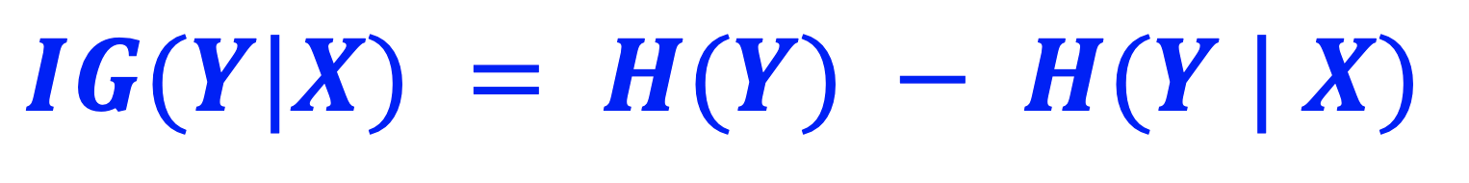
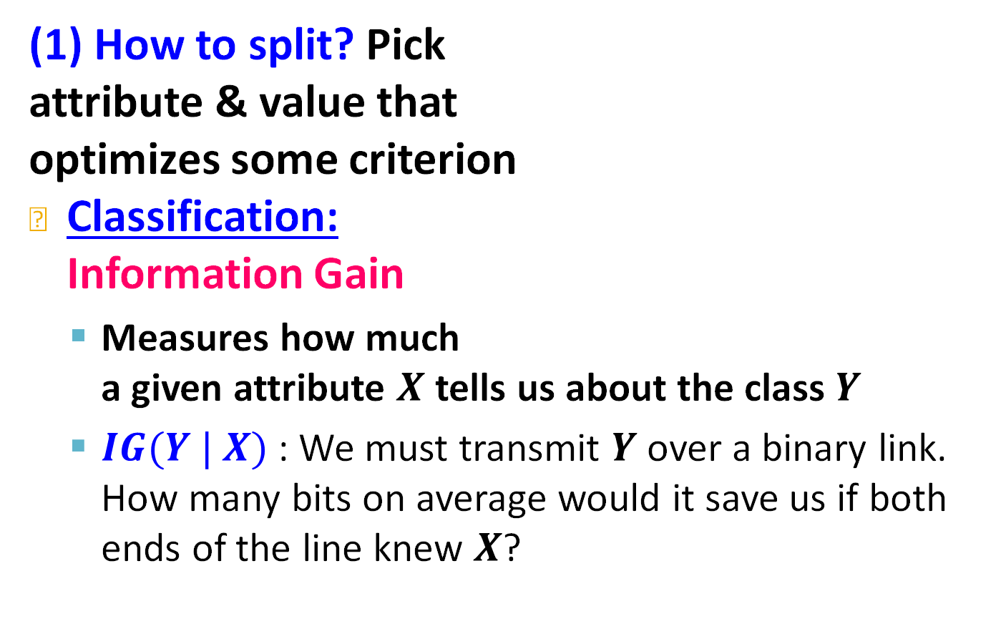
How to construct a tree?
(1) How to split? Pick attribute & value that optimizes some criterion
Classification: Information Gain
Measures how much a given attribute $X$ tells us about the class $Y$
$IG(Y | X)$: We must transmit $Y$ over a binary link. How many bits on average would it save us if both ends of the line knew $X$?
A
|D|=10
|D|=90
X⁽¹⁾<v⁽¹⁾
.42
B
C
|D|=45
|D|=45
X⁽²⁾<v⁽²⁾
D
E
|D|=20
|D|=25
|D|=15
|D|=30
X⁽³⁾<v⁽⁴⁾
X⁽²⁾<v⁽⁵⁾
F
G
H
I
Notes:
How much infrmation does x provide about y

Slide 18
If X and Y are independent -> IG(Y|X) = 0
When choosing a feature for split, ideally you should choose a feature that tells you alot about Y. ➔ IG(Y|X) should be high.
Y = lifespan
Xs = {eyecolor, smoker, gender}
IG(lifespan|gender) = 0.2
IG(lifespan|smoker) = 0.6
IG(lifespan|eyecolor) = 0.001

Slide 19
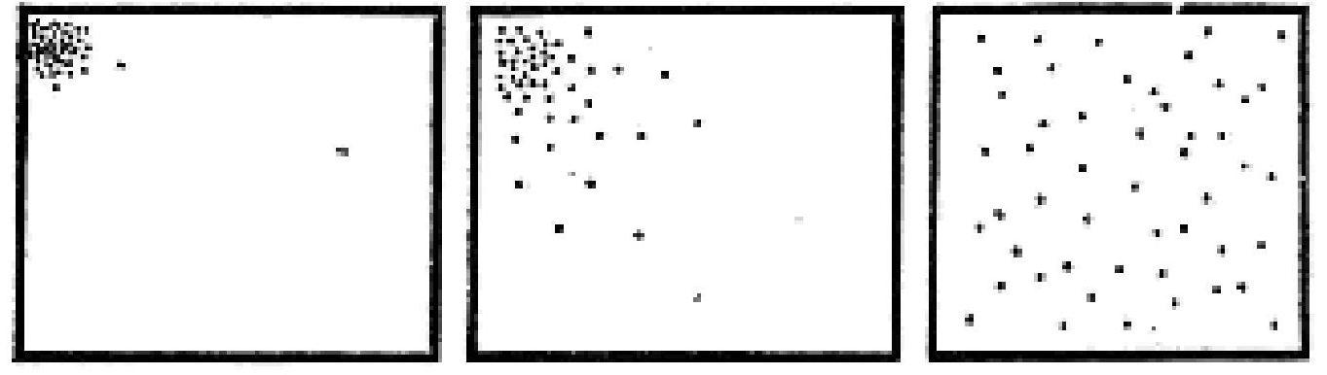
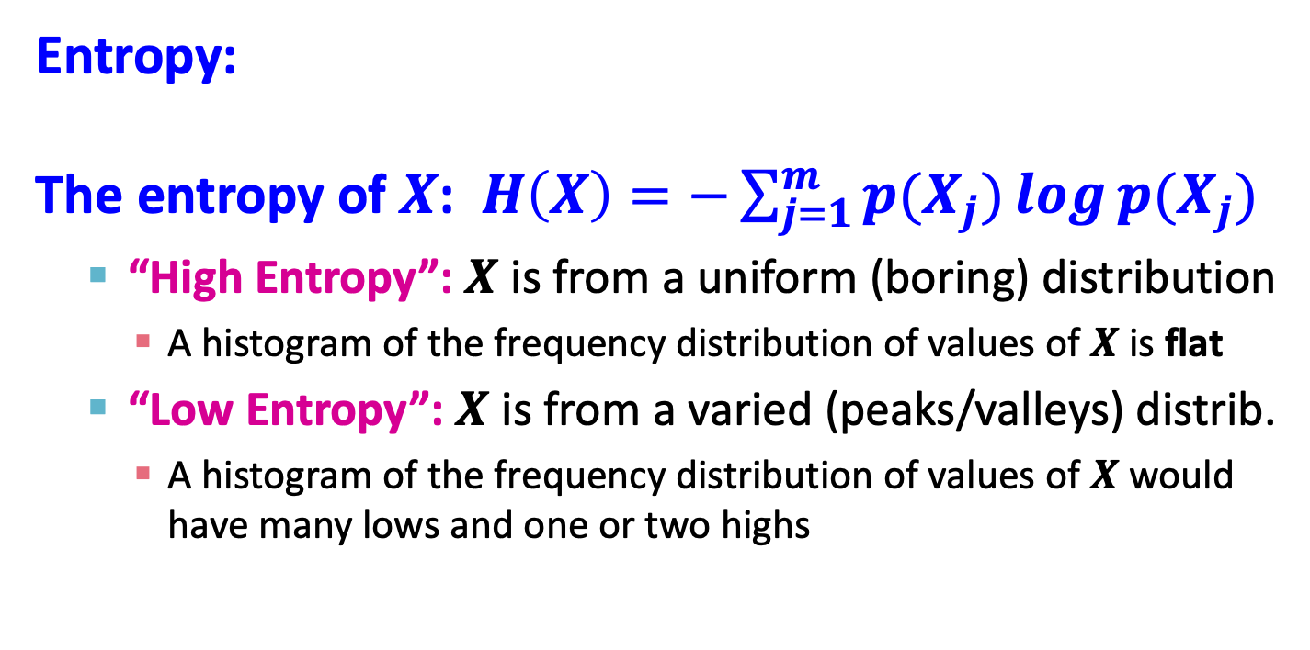
Why Information Gain? Entropy
Entropy:
The entropy of $X$: $H\left(X\right)=−\sum_{j=1}^{m}{p(X_{j})\log{p(X_{j})}}$
“High Entropy”: $X$ is from a uniform (boring) distribution
A histogram of the frequency distribution of values of $X$ is flat
“Low Entropy”: $X$ is from a varied (peaks/valleys) distrib.
A histogram of the frequency distribution of values of $X$ would have many lows and one or two highs
Low entropy
High entropy
Notes:
We are going to build this up through a sequence of steps
This is a information theoretic measure. Information theory is based on entropy.
Low entropy = deterministic distribution
High entorpy = uncertain distribution
Distributions of particles. A new particle comes , for the distribution on the right we cant tell where particle belongs to because all postiions are equally likely.
The maximum value of entropy is log𝑘log⁡�, where 𝑘� is the number of categories you are using. Its numeric value will naturally depend on the base of logarithms you are using.

Slide 20
Entropy
Entropy = uncertainty
Random variable Y = {1} → H(Y) = 0
Random variable Y = {0 (pr 0.5) , 1 (pr 0.5)} → H(Y) = 1

Slide 21
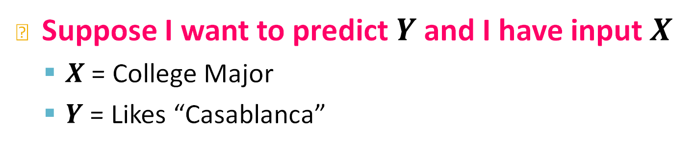
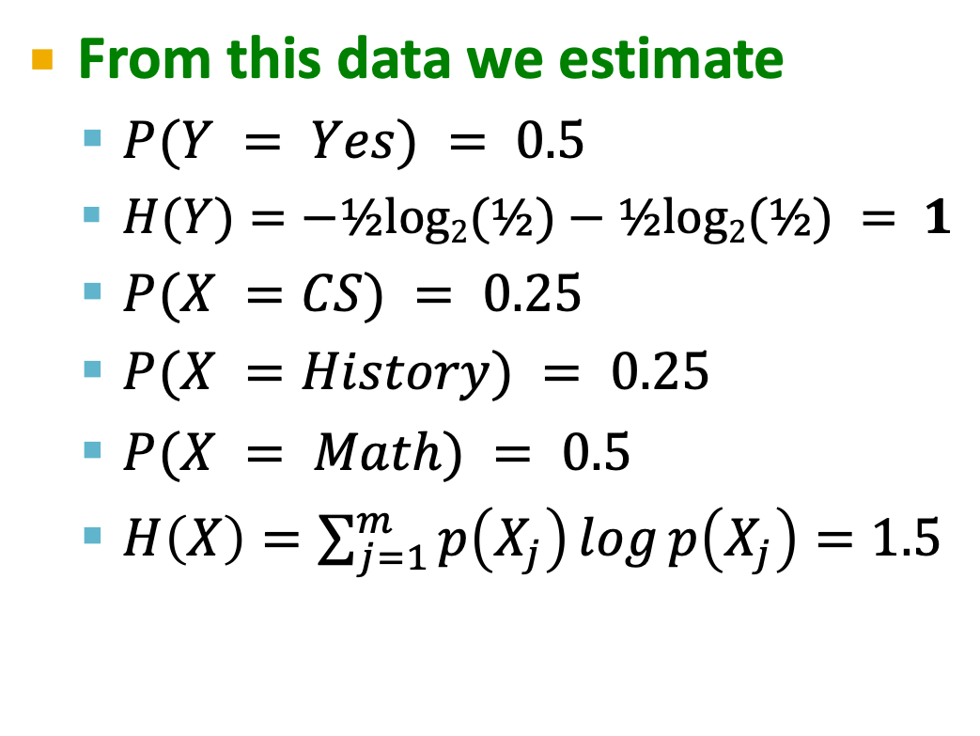
Why Information Gain? Entropy
Suppose I want to predict $Y$ and I have input $X$
$X$ = College Major
$Y$ = Likes “Casablanca”
From this data we estimate
$P(Y = Yes) = 0.5$
$H(Y)=−½log2(½)−½log2(½) = 1$
$P(X =CS) = 0.25$
$P(X =History) = 0.25$
$P(X = Math) = 0.5$
$H\left(X\right)=\sum_{j=1}^{m}{p\left(X_{j}\right)\log{p\left(X_{j}\right)}}=1.5$
X | Y
Math | Yes
History | No
CS | Yes
Math | No
Math | No
CS | Yes
Math | Yes
History | No
Notes:
X a distribution over math, CS and history

Slide 22
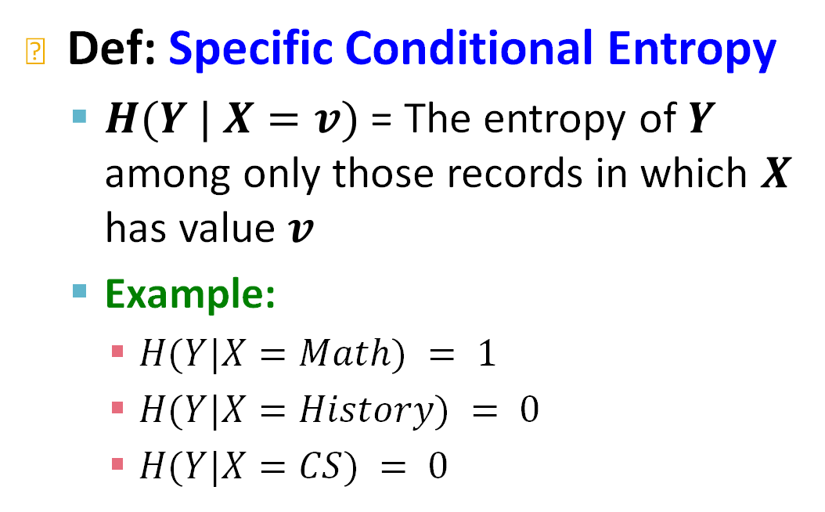
Why Information Gain? Entropy
Suppose I want to predict $Y$ and I have input $X$
$X$ = College Major
$Y$ = Likes “Casablanca”
Def: Specific Conditional Entropy
$H(Y | X=v)$ = The entropy of $Y$ among only those records in which $X$ has value $v$
Example:
$H(Y|X=Math) = 1$
$H(Y|X=History) = 0$
$H(Y|X=CS) = 0$
X | Y
Math | Yes
History | No
CS | Yes
Math | No
Math | No
CS | Yes
Math | Yes
History | No

Slide 23
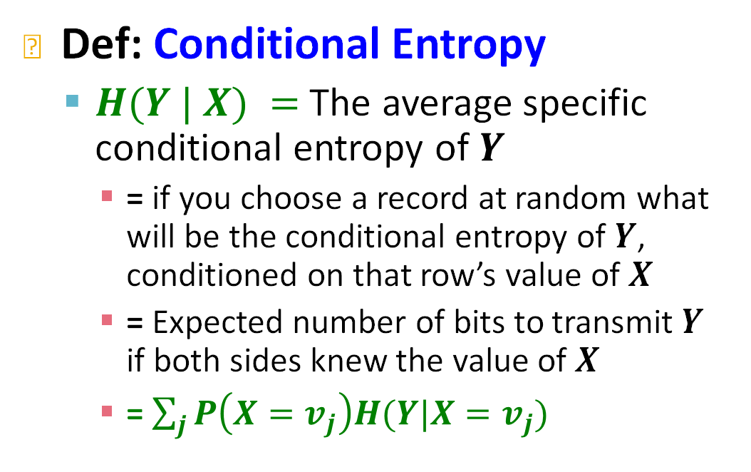
Why Information Gain?
Suppose I want to predict $Y$ and I have input $X$
$X$ = College Major
$Y$ = Likes “Casablanca”
Def: Conditional Entropy
$H(Y | X) =$ The average specific conditional entropy of $Y$
= if you choose a record at random what will be the conditional entropy of $Y$, conditioned on that row’s value of $X$
= Expected number of bits to transmit $Y$ if both sides knew the value of $X$
= $\sum_{j}{P\left(X=v_{j}\right)H(Y|X=v_{j})}$
X | Y
Math | Yes
History | No
CS | Yes
Math | No
Math | No
CS | Yes
Math | Yes
History | No
Notes:
Average of “specific conditional entropy”
Expected number of bits we need to send if both sides know X

Slide 24
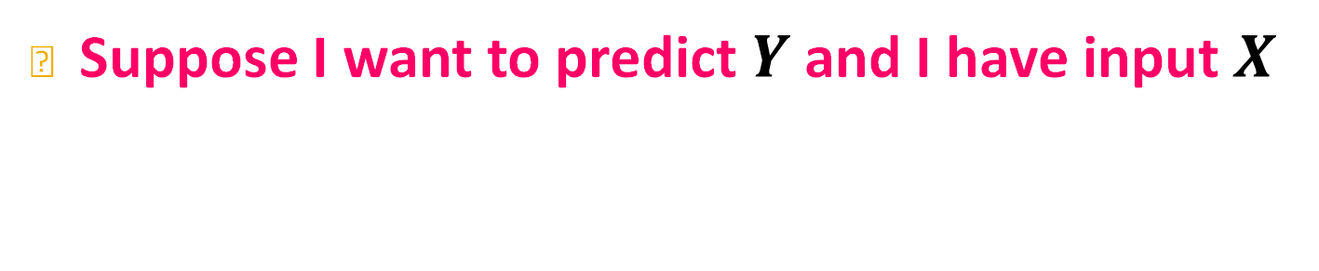

Why Information Gain?
Suppose I want to predict $Y$ and I have input $X$
$H(Y | X) =$ The average specific conditional entropy of $Y$
$$=\sum_{j}{P\left(X=v_{j}\right)H(Y|X=v_{j})}$$
Example:
So: H(Y|X)=0.5*1+0.25*0+0.25*0 = 0.5
X | Y
Math | Yes
History | No
CS | Yes
Math | No
Math | No
CS | Yes
Math | Yes
History | No
V_{j} | P(X=v_{j}) | H(Y|X=v_{j})
Math | 0.5 | 1
History | 0.25 | 0
CS | 0.25 | 0
Notes:
Entropy is defined over discrete and categorical variable, its almost like variance over categorical data.
variance is defined over continuous variable

Slide 25
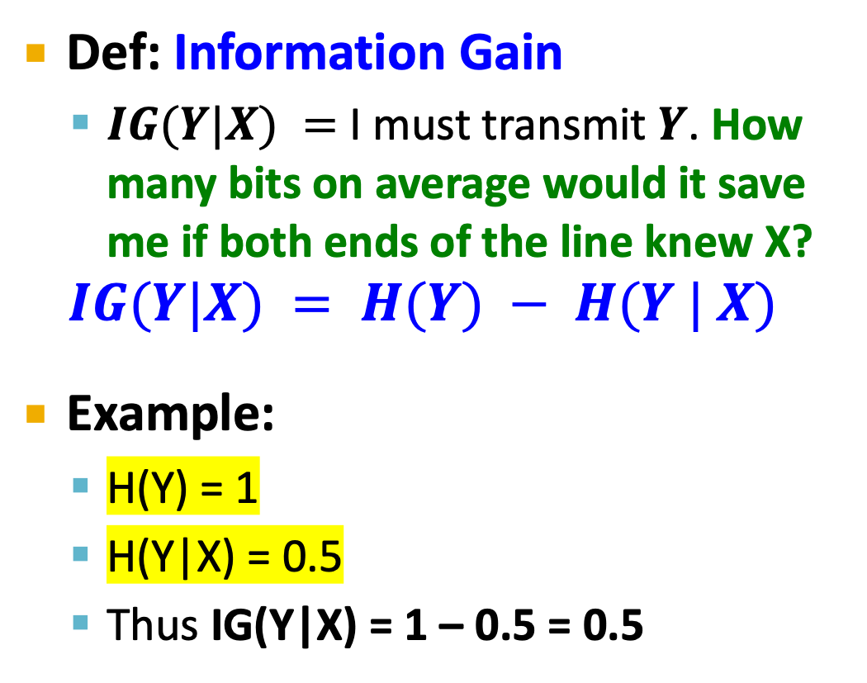
Why Information Gain?
Suppose I want to predict $Y$ and I have input $X$
Def: Information Gain
$IG(Y|X) =$ I must transmit $Y$. How many bits on average would it save me if both ends of the line knew X?
$$IG(Y|X) = H(Y) − H(Y | X)$$
Example:
H(Y) = 1
H(Y|X) = 0.5
Thus IG(Y|X) = 1 – 0.5 = 0.5
X | Y
Math | Yes
History | No
CS | Yes
Math | No
Math | No
CS | Yes
Math | Yes
History | No
Notes:
Missing values in features? IG metric assumes no missing value.
Either ignore missing values or impute them with average or a special value reserved for missing.

Slide 26
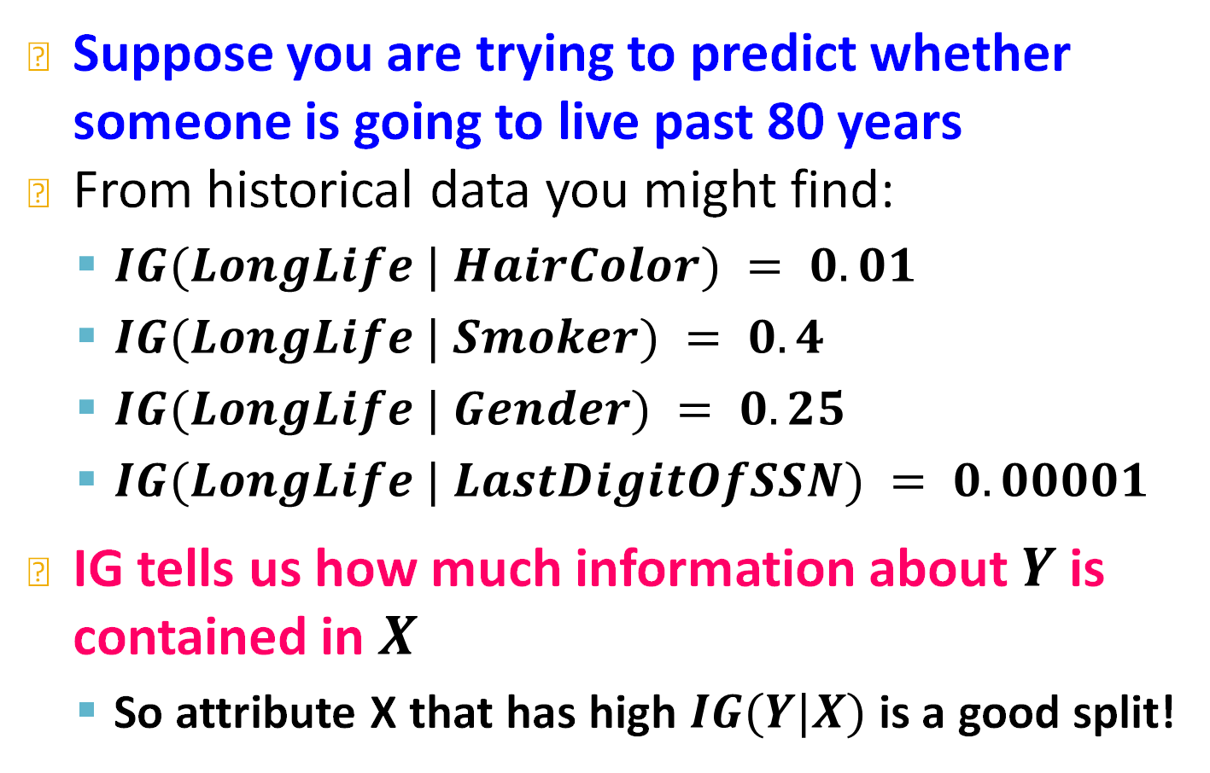
What is Information Gain used for?
Suppose you are trying to predict whether someone is going to live past 80 years
From historical data you might find:
$IG(LongLife | HairColor) = 0.01$
$IG(LongLife | Smoker) = 0.4$
$IG(LongLife | Gender) = 0.25$
$IG(LongLife | LastDigitOfSSN) = 0.00001$
IG tells us how much information about $Y$ is contained in $X$
So attribute X that has high $IG(Y|X)$is a good split!

Slide 27
3 steps in constructing a tree
BuildSubtree
(1)
(2)
(3)
BuildSubtree
BuildSubtree

Slide 28
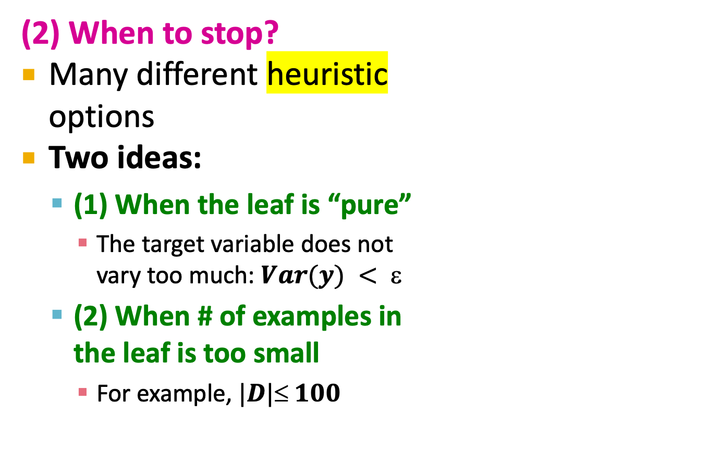
When to stop?
(2) When to stop?
Many different heuristic options
Two ideas:
(1) When the leaf is “pure”
The target variable does not vary too much: $Var(y) < $
(2) When # of examples in the leaf is too small
For example, $|D| 100$
A
|D|=10
|D|=90
X⁽¹⁾<v⁽¹⁾
.42
B
C
|D|=45
|D|=45
X⁽²⁾<v⁽²⁾
D
E
|D|=20
|D|=25
|D|=15
|D|=30
X⁽³⁾<v⁽⁴⁾
X⁽²⁾<v⁽⁵⁾
F
G
H
I
Notes:
Perhaps we can address these stopping criteria as an approach to deal with overfitting, and mention that we will address overfitting issues further in ensembles

Slide 29
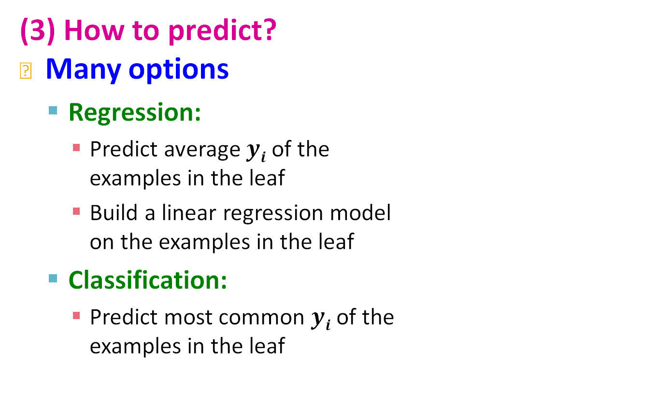
How to predict?
(3) How to predict?
Many options
Regression:
Predict average $yi$ of the examples in the leaf
Build a linear regression model on the examples in the leaf
Classification:
Predict most common $yi$of the examples in the leaf
A
|D|=10
|D|=90
X⁽¹⁾<v⁽¹⁾
.42
B
C
|D|=45
|D|=45
X⁽²⁾<v⁽²⁾
D
E
|D|=20
|D|=25
|D|=15
|D|=30
X⁽³⁾<v⁽⁴⁾
X⁽²⁾<v⁽⁵⁾
F
G
H
I

Slide 30
Decision Trees
Characteristics
Classification & Regression
Multiple (~10) classes
Real valued and categorical features
Few (hundreds) of features
Easy to understand and interpret
Complicated decision boundaries
Early stopping to avoid overfitting!
Notes:
Not millions of features
They are robust and are used all over industry. Easy to understand, interpretable, mititgate overfitting, easy to make progress on it and iterate on them.

Slide 31
Decision Trees
Decision trees are the single most popular data mining tool:
Easy to understand
Easy to implement
Easy to use
Computationally cheap
It’s possible to mitigate overfitting (i.e., with ensemble methods)
They do classification as well as regression!

Slide 32
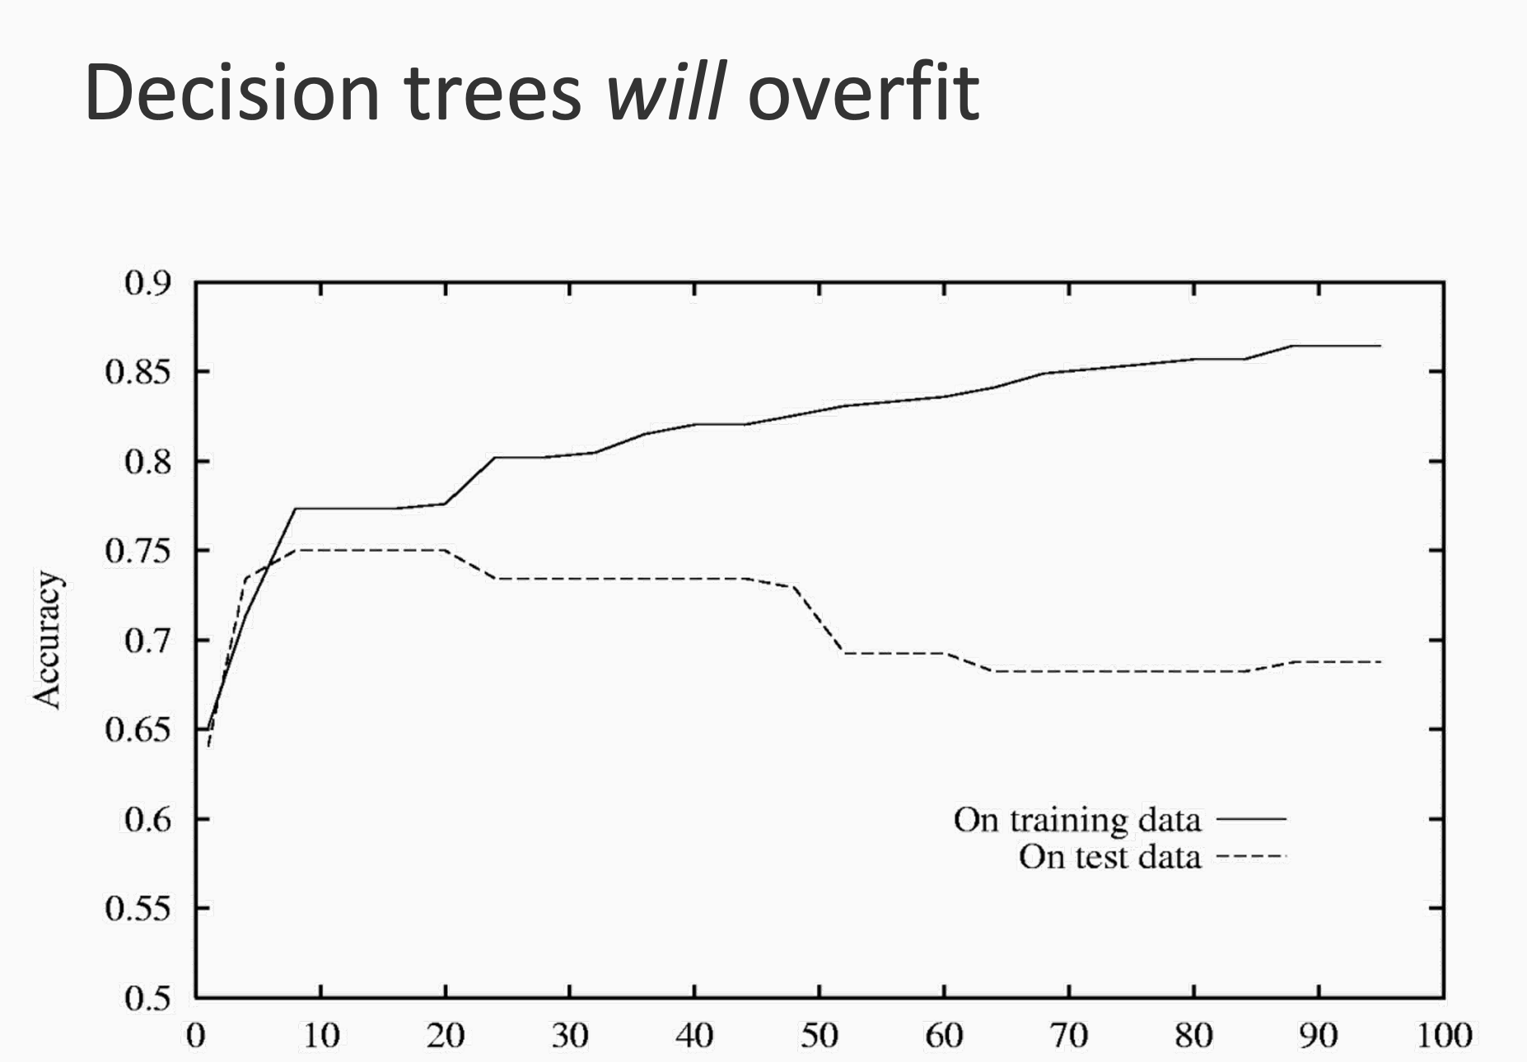
Avoiding overfitting

Slide 33
Avoiding overfitting
Pruning:
Pre-pruning:
This involves stopping the tree from growing once it reaches a certain depth or has a minimum number of samples per leaf node.
Parameters to control:
max_depth: Maximum depth of the tree.
min_samples_split: Minimum number of samples required to split a node.
min_samples_leaf: Minimum number of samples required to be at a leaf node.

Slide 34
Avoiding overfitting
Pruning:
Post-pruning:
Not common. Involves growing the tree fully and then trimming back branches that have little importance.
Computationally expensive
Limit number of features for split
Use square root number of features at each split

Slide 35
Avoiding overfitting
Cross-Validation
Use k-fold cross-validation
Evaluate how well your model generalizes to unseen data.
This will help in selecting the best hyperparameters (such as depth, minimum samples, etc.)
Limit Leaf Nodes
to avoid the tree growing too large and capturing noise in the training data

Slide 36
Avoid overfitting
Use ensemble methods
Random Forest or Gradient Boosting
Decision stump = of depth 2

